Slide 1
Energy-Aware Scheduling Algorithms
Lecture 8

Slide 2
Outline
Embedded Processor
  Low Power Design Considerations
    RISC and code density
    Low power and power management
Embedded OS

Slide 3
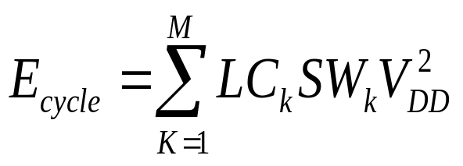
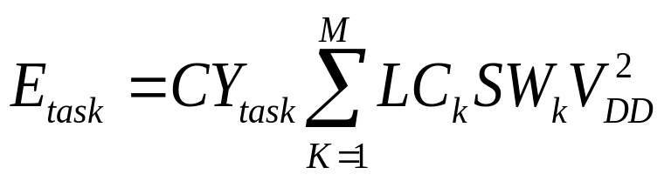
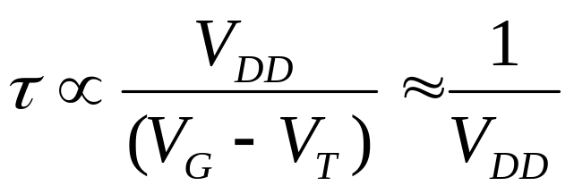
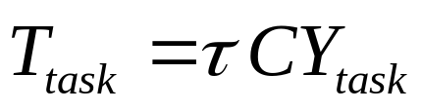
Power Delay Trade-off
Lower supply voltage => lower power/energy consumption
Lower power/energy consumption => higher circuit delay/execution time
M = # of tasks
CY=cycles
LC = Load capacitance
SW=Switch capacitance
Vdd=Supply voltage
Notes:
M = # of tasks
CY=cycles
SW=Switch capacitance

Slide 4
Variable Voltage Processors
Variable voltage generated by DC-DC switching regulators
  DC-DC switching regulators with fast transition times.
  time and power overhead of switching are negligible.
Vdd
control
ROM
CPU
RAM
Vdd CLK
Vdd CLK
Vdd CLK
DC-DC converter & Voltage Controller

Slide 5
Variable Voltage Processors
Voltage can be changed by the instructions in applications or operating system.
Clock frequency is adjusted according to the voltage.
High supply voltage
  high execution speed -> tasks with severe timing constraints
Low supply voltage
  low execution speed -> tasks with loose timing constraints

Slide 6
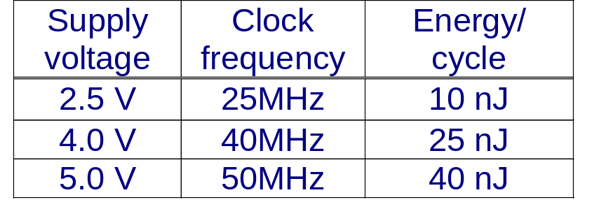
How the clock rate affects the energy consumption and timing constraint?
5.0²
40 J
Time constraint
1 billion cycles
Energy consumption (∝V_{DD})
0 5 10 15 20 25 Time(seconds)
5.0²
32.5 J
750 million cycles
250 million
cycles
2.5²
0 5 10 15 20 25 Time(seconds)
5.0²
25 J
4.0²
1 billion cycles
0 5 10 15 20 25 Time(seconds)

Slide 7
Load Capacitance
Capacitive load
LC₁ 2.0 F
X₁ 250 million cycles
Energy consumption (∝V_{DD})
5.0²
Task1
750 million cycles
2.5²
250 million
cycles
0 5 10 15 20 25 Time(seconds)
Task2
5.0²
25 J
4.0²
LC₂ 0.5 F
X₂ 750 million cycles
1 billion cycles
0 5 10 15 20 25 Time(seconds)
Notes:
.What is load capacitance (CL)?
CL stands for Load Capacitance. Load capacitance is defined as being the total capacitance present in an oscillator circuit as measured or calculated across the pins of the crystal. In order for the quartz crystal unit to function in a normal manner, there has to be some defined capacitance in oscillation circuit to match the crystal.
3.The load capacitance (CL) of my resonant crystal is rated at 16pF. How do I calculate the value of the load capacitors used in my parallel resonant oscillator circuit?
Use this formula to approximate the value of capacitors needed:
CL=((Ci x Co) / (Ci + Co)) + Cstray
Cstray is the stray capacitance in the circuit, typically 2-5pF. If the oscillation frequency is high, the capacitor values should be increased to lower the frequency. If the frequency is low, the capacitor values should be decreased, thus raising the oscillation frequency. When CL =16pF, Ci and Co will be approximately 22-30pF each, plus the additional stray capacitance.

Slide 8
Challenges
Effective scheduling techniques that treat voltage as variable
to be determined, in addition to conventional task scheduling.
Real-time application consists of two or more tasks.
Variable-voltage processor uses few discrete voltages.
Switch capacitance is different for each task.
Tasks may end earlier then in worst-case execution cycles.
Scheduler can not schedule tasks before their arrival times.

Slide 9
Voltage Scheduling Techniques
Static voltage scheduling
  target system assumption
  ILP problem formulation
Dynamic voltage scheduling
  target system assumption
  SD and DD algorithms

Slide 10
Static Scheduling - Target System
hard real-time systems
dynamically adjustable supply voltage
one supply voltage at a time
few discrete voltages
adaptive clock scheme
worst-case execution cycles can be estimated statically
no power overhead due to DC-DC switches
no time overhead due to voltage and clock changing

Slide 11
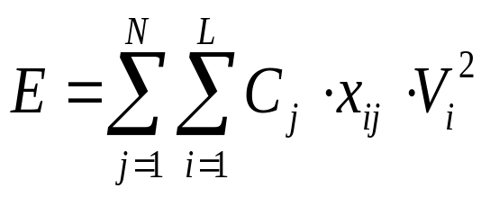
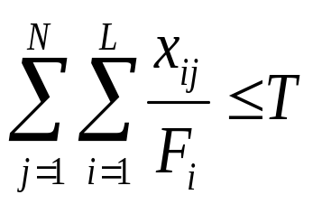
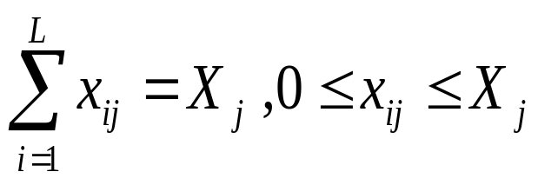
Static Voltage Scheduling
VOLTAGE SCHEDULING PROBLEM
…for the given {task_{j}} and {mode_{i}}, find x_{ij}, that minimizes E and satisfies time constraint T.
minimize
subject to
N - number of tasks
task_{j}=(X_{j},C_{j}) - the jth task
X_{j} - number of cycles of the jth task
C_{j} - average capacitve load for jth task
L - number of variable voltages
Mode_{i}=(V_{i},F_{i}) - processor’s execution mode
V_{i} - ith voltage
F_{i} - clock frequency with V_{i}
T – the global deadline for all tasks
x_{ij} - number of cycles of task_{j} executed with V_{i}

Slide 12
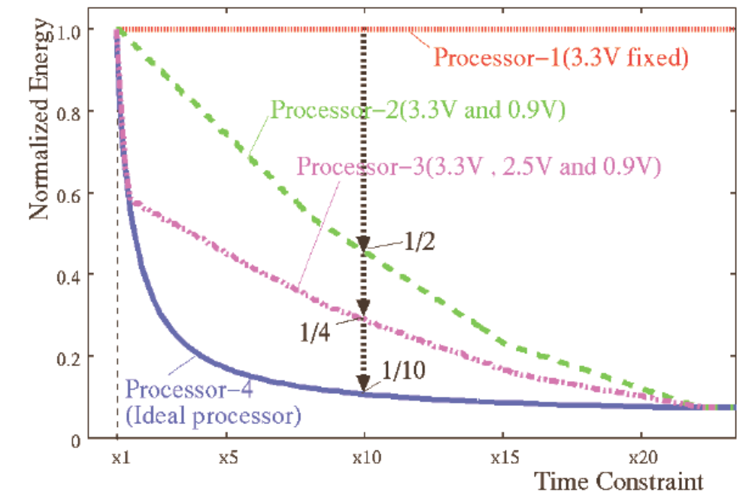
Static Scheduling - Experimental Results
Larger number of variable voltages => power reduction
Suitable voltage for the time constraint => significant power reduction
Tasks with lower capacitance, assigned higher voltage => 30% reduction of energy consumption

Slide 13
Dynamic Voltage Control
Target systems:
  Uni-processor systems.
  Only OS can issue voltage control instructions.
  Voltage can be changed at any time.
  Only one supply voltage is used at any time.
  Runtime and power overhead is negligible.
  Static determination of worst case execution cycles (WCEC).

Slide 14
Challenges for Schedulers
Task 1
Task 2
Task 3
What is the optimum supply voltage assignment for each task in order to obtain minimum energy consumption?

Slide 15
Dynamic Scheduling - Notation
TASK PARAMETERS
a_{i} - arrival time
O_{i} - worst-case execution time
d_{i} - deadline
s_{i} - execution start time
e_{i} - execution completion time
L_{i} - remaining time : L_{i}=d_{i}-e_{i}
ENERGY CONSUMPTION PARAMETERS
X_{i} - worst case execution cycle
Fi - clock frequency with J_{i}
V_{i} - supply voltage when J_{i} executes
C_{i} - average capacitive load
E_{i} - worst-case energy consumption
O_{i}=X_{i}/F_{i}
TASK J_{i}
O_{i}
L_{i}
a_{i} s_{i} e_{i} d_{i}
PROCESSOR PARAMETERS
(v_{j},f_{j}) - processor mode
m= (v_{j},f_{j}) - number of processor modes
V_{max}=max(v_{i}) - largest supply voltage
E_{i}=C_{i}X_{i}V_{i}²

Slide 16
Possible Solutions
Occupied Interval
T
Task 2
Start Time
End Time
Once the occupied interval for each task is determined:
The task is executed at a frequency of WCEC/T hz.
The scheduler assigns start and end times of time slot.

Slide 17
Dynamic Voltage Scheduling Algorithms
Target systems
  real-time system (RTOS + applications)
  application programs divided in tasks
  task can vary supply voltage
  preemptive tasks
Arrival times of tasks are known
  SD algorithm: static ordering and dynamic voltage assignment
Arrival times of tasks are unknown
  DD algorithm: dynamic ordering and dynamic voltage assignment

Slide 18
Algorithm Steps
CPU time allocation
  all tasks execute on V_{max}
  execution cycle = worst case execution cycle
End-time prediction
  The end time of occupied interval for next executed task is predicted.
Start-time assignment
  The start-time of occupied interval is determined.
  One’s occupied interval can be prolonged if the previous task finishes earlier.

Slide 19
SD Algorithm
Arrival times of all tasks are known.
Deadlines of all tasks are known.
WCEC of all tasks are known.
SD Algorithm:
  The execution order of all tasks are determined off-line.
  The supply voltage are determined on-line.
  CPU time is assigned to each task:
    Assuming maximum supply voltage.
    Assuming WCEC.

Slide 20
Dynamic Voltage Control
For the worst case, both tasks require WCEC and maximum voltage to complete.
Task 1
Task 2
Task 1 completes earlier. SD algorithm adjusts the voltage for Task 2 without affecting other tasks
Task 1
Task 2

Slide 21
DD Algorithm
Arrival times of all tasks are unknown.
Deadlines of all tasks are known.
WCEC of all tasks are known.
DD Algorithm:
  Determines the start time and voltage for all the tasks on-line.
  When new task arrives, it either:
    Preempts current task or
    Starts after current task completes.

Slide 22
Dynamic Voltage Control
Task 1
Task 2
Task 1 completes earlier. SD algorithm adjusts the voltage for Task 2 without affecting other tasks
Current Time
Task 1
Task 2

Slide 23
Experimental Results
SD algorithm
  better results than the normal case
  looser deadline constraints => better energy reduction
DD algorithm
  better results than the normal case
  power consumption independent of deadline constraints
Notes:
power consumption independent of deadline constraints.

Slide 24
Summary
Voltage scheduling algorithms are designed to minimize the energy consumption subject to the timing constraint.
Static and dynamic voltage control algorithms are introduced in this lectures.
There are other voltage control algorithms for different target systems.

Slide 25
Questions ?

